Slide 1
Network Policy
13% – Services & Networking

Slide 2


Network policy
Kubernetes defaults to no Ingress/Egress restrictions on Pods (Allow All)
Any pod can send traffic to any other pod
Network Policies can be applied to resources to restrict communications
Once a network policy is applied to a pod ALL traffic is blocked unless a rule allows (Allow None)
Web
Service
API
DB
Network Policy

Slide 3
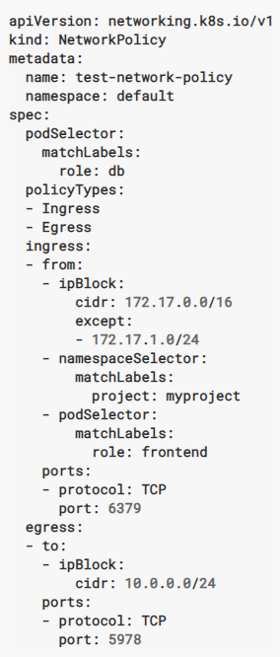
Structure of a Network Policy
Mandatory fields
Label-based selection of Pods in the above-mentioned namespace to which the Policy applies
Indicates whether the policy applies to ingress traffic, egress traffic or both – Ingress always set by default
Set of Ingress rules to allow traffic to the selected Pods
Traffic allowed from endpoints matching one or more of the specified sources on the specified port - IP CIDR range, Pod Namespace, Pod Label
Pod and Namespace selectors can be combined into a single rule by specifying them one after the other – this allows specific Pods in a specific namespace
If Ingress section is absent or empty, then all Ingress traffic is denied
IP CIDR should be sources outside the cluster as Pod IPs are ephemeral
Set of Egress rules that define destinations (and port) to which traffic is allowed from the Pods selected earlier
Notes:
FT list of whitelisted domains is available but not sure if it is thorough

Slide 4
Question
Create a pod
Assign the name nginx-pod
Use the nginx image
Add the label “app” with a value of “test”
Expose pod using a ClusterIP service on port 80
Prevent all connections to pod unless the pod has a label of role=debug
Notes:
C:\Projects\Ingress Example\readme.md

